Slide 1
IMAGE-BASED PLANT DISEASE DETECTION USING DEEP LEARNING
PROJECT GUIDE:-MR.Naga Sudheer Bandlamudi
Done By
191FA0f7098-B.Gowtham Sai
191FA07126-T.Sai Swaroop
191FA07132-G.Bhanu Prakash

Slide 2
ABSTRACT
Agriculture plays a crucial role in the Indian economy. Early detection of plants is very much essential to prevent crop loss and further spread of diseases.
Most plants shows visible symptoms of the disesase on the leaf. Hense visible patterns can be identified to correctly to predict the disease and take early action to prevent from damage of plants.
The conventional method is the farmers manually observe the plant leaf and identify the type of disease.
In this project, a Deep Learning model is trained to classify the different plant diseases.
The Convolutional Neural Network(CNN) modes is used due to its massive success in image-based classification. The Deep Learning model provides faster and more accurate predictions than manual observation of the plant leaf.

Slide 3
Problem Statement
Plant Disease is the significant challange in the Agriculture Sector. Some of the plants shows visible symptoms on the plant leaf. These leaf patterns can be used to identify different diseases and take immediate action to prevent from spreading of the disease.
Most of these plant diseases are difficult to detect through naked eyes.
There are much research works done for plant leaf dieases identification using Machine Learning and Deep Learning models.

Slide 4
Objectives
We are going find out whether the leaf is diseased or healthy, certain steps must be followed. i.e., Preprocessing, Feature extraction, Training of classifier and Classification.
Preprocessing of image, is bringing all the images size to a reduced uniform size.
Then comes extracting features of a preprocessed image which is done with the help of HOG.

Slide 5
Why Deep Learning
Deep Learning is a type of Machine Learning and Artificial Intelligence that imitates the way humans gain certain types of knowledge.
The deep learning model uses an artifical neural network that can learn features from an input image and make intelligent decisions on its own.
Thus deep learning models are far more capable than the standard machine learning models for image-based classification.

Slide 6
Why Convolutional Neural Network(CNN)
The working model uses convolutional neural networks and transfer learning to classify different plant diseases.
CNN is a type of deep learning neural network and has good success in image-based classification.
The proposed system is faster and more accurate than the conventional way of manual observation of each plant.
Deploying such project into web application can help farmers to detect disease of the plant by pictures and take necessary actions to avoid diseases spread.

Slide 7
Methodology
Step 1 : Firstly, collecting data from the freely available open source dataset , The dataset consists of both healthy and infected leaves.
Step 2 : Now , the images are resized to smaller pixel size in order to speed up the computations. The acquired images contain some noise, this noise is removed using some filtering techniques.
Step 3 : After that images are present in RGB format which is not appropriate for further work as RGB format is unable to separate image intensity.

Slide 8
Methodology
Step 4 : Hence it is converted to another color space that is HSV which separate color from intensity. Also, RGB color space is noisier than HSV.
Step 5 : In this step, segmentation of images is done in order to separate the leaves from the background , segmentation is done through k-means clustering.
Step 6 : Now, we have to classify the type of disease on the leaf of the plant. So, we have plenty of machine learning algorithms that we can apply on this dataset.

Slide 9
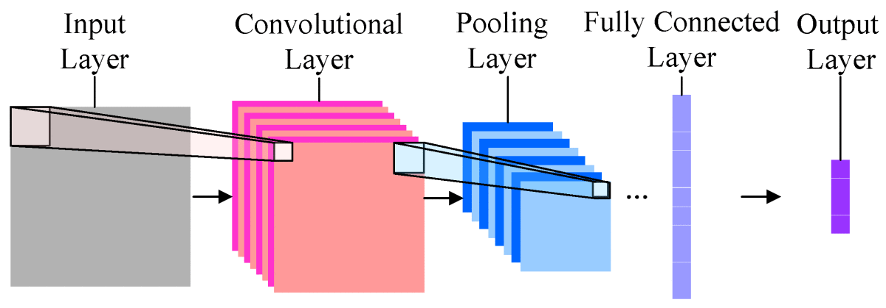
Convolutional Neural Network

Slide 10
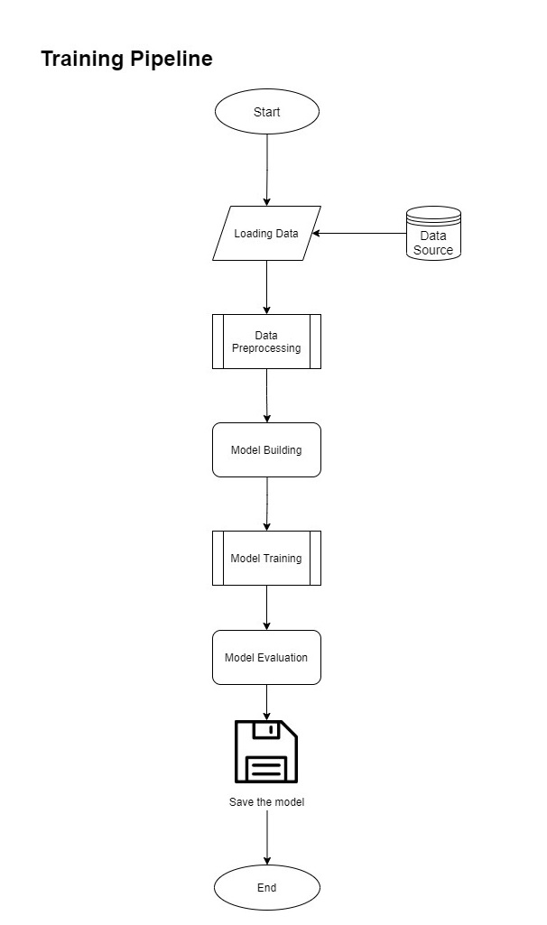

Slide 11
Datasets
 | Training Data | Validation Data
No. of Fresh Tomato Leaf Images | 427 | 80
No. of Diseased Tomato Leaf Images | 288 | 55
Total No. of Images | 715 | 135

Slide 12
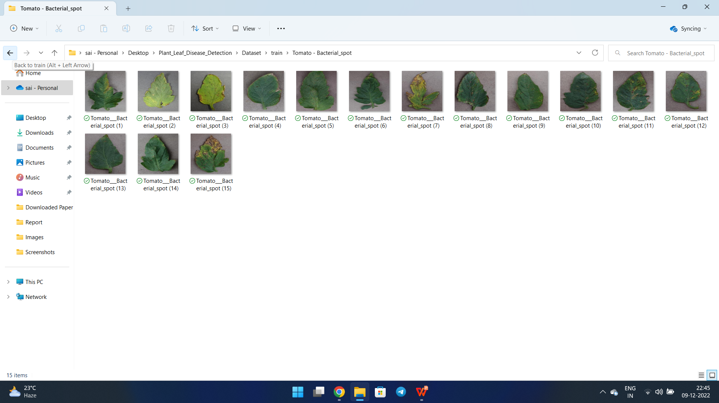
Sample Datsets

Slide 13
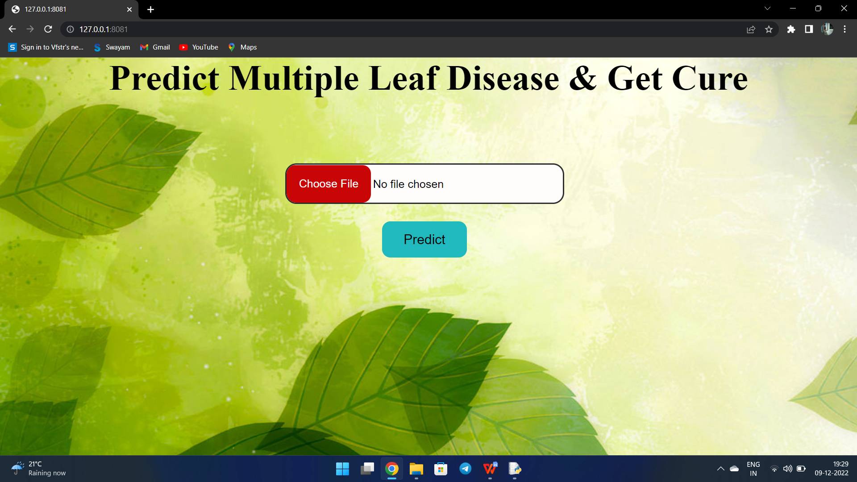
Results

Slide 14
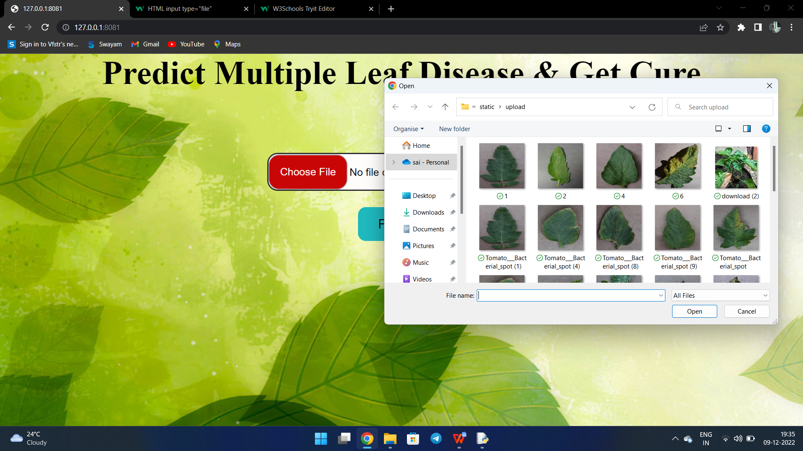

Slide 15
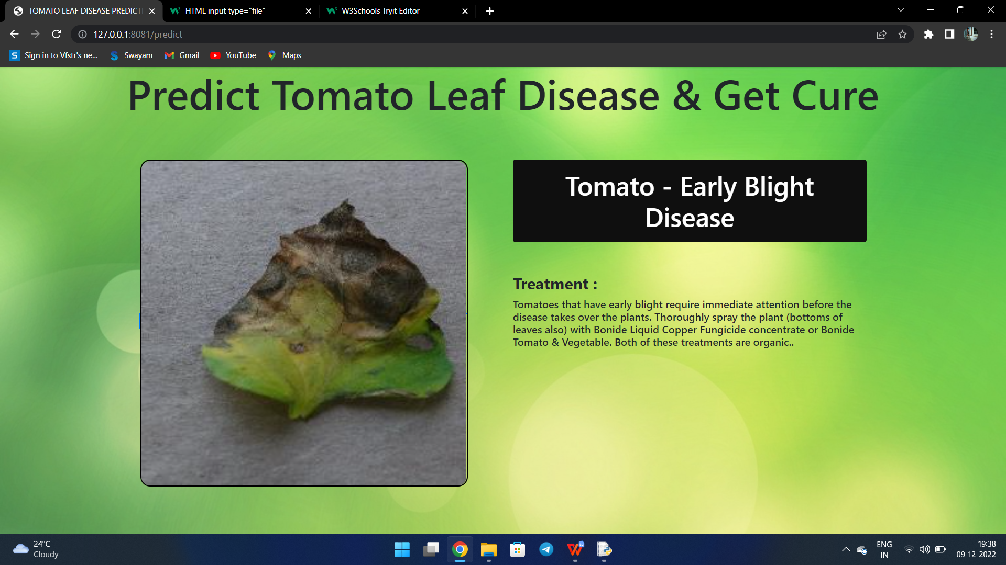

Slide 16
Future Work
Future scope of this project will involve adding more parameters and factors like the financial ratios, multiple instances, etc.
The more the parameters are taken into account more will be the accuracy. The algorithms can also be applied for analyzing the contents of public comments and thus determine patterns/relationships between the customer and the corporate employee.

Slide 17
THANK YOU

